Slide 1
CO2402 - Advanced Programming with C++
Week 1 - Introduction
Gareth Bellaby

Slide 2
Introduction

Slide 3
Lectures and Practicals
Lecture, Tuesday 3 – 4
Tuesday 4 – 5. Games B. CM25. Laurent.
Thursday 2 – 3. Games A. FY217. Gareth.
Friday 2 – 3. CM26. Gareth
  Software Engineering
  Networks
  Forensics
  Mobile Interactive Technology
  Combined Honours

Slide 4
Relevance
All of the material is relevant to you. My aim is only to teach relevant material in the lectures.
I'll also provide material which has technical significance but which is of less direct relevance in a supplement.
I'll try to indicate the relevance of material. However, if you don't see the relevance of something being taught is then ask.

Slide 5
Work
1 hour lecture. I expect you to bring pen and paper and make notes.
1 hour practical in the labs.
1 hour is not enough. Do not expect to do well, or even to pass, if you merely attend the lecture and practical.
The worksheets are intended to take longer than 1 hour. You must complete the worksheets in the week of the lecture.
You must put in extra work yourself. Use one (or more) of the recommend books.
I expect 4 hours extra hours from you.

Slide 6
Books
You must buy one of the recommended books. A programming book is essential in order to program well.
You need a book that will work as a reference.
You need an alternative explanation of material.
You need exercises to practice.
C++ is a wide topic and it is beyond the scope of this module to cover it in all its detail.

Slide 7
Books
Stanley B Lippman, Josee Lajoie, Barbara E Moo, (2005), C++ Primer, 4th Ed, Addison Wesley. ISBN-13: 978-0201721485
Jesse Liberty, Siddhartha Rao, Bradley L. Jones , (2008), Sams Teach Yourself C++ in One Hour a Day. Sams. ISBN-10: 0672329417. ISBN-13: 978-0672329418.
Francis Glassborow, (2006), You Can Program in C++, John Wiley and Sons. ISBN-13: 978-0470014684
Paul J. Deitel & Harvey M. Deitel, (2009), C++ for Programmers. Prentice Hall. ISBN-10: 0137001304. ISBN-13: 978-0137001309.
Walter Savitch, (2008), Problem Solving with C++, 7th edition, Pearson Education, ISBN-13: 978-0321549402
Walter Savitch, (2007), Absolute C++, 3rd edition, Pearson Education. ISBN-13: 978-0321494382.

Slide 8
Books - Advanced
Andrei Alexandrescu, Scott Meyers, John Vlissides, (2001), Modern C++ Design, Addison Wesley. ISBN-13: 978-0201704310
Andrew Koenig, Barbara E. Moo, (2000), Accelerated C++: Practical Programming by Example, Addison Wesley. ISBN-13: 978-0201703535.
Noel Llopis, (2003), C++ for Game Programmers, Charles River Media. ISBN-13: 978-1584502272

Slide 9
Bjarne Stroustrup
Bjarne Stroustrup, The C++ Programming Language, (1997 or 2000), Third Edition or Special Edition, Addison Wesley. ISBN-13: 978-0201889543
Bjarne Stroustrup, (1994), The Design and Evolution of C++, Addison Wesley. ISBN-13: 978-0201543308.
His web site is here:
  http://www.research.att.com/~bs/C++.html
I would strongly recommend looking at his material.

Slide 10
Schedule
Schedule may be revised. Depends on the feedback I get.
Considering bringing forms forward (week 2 or 3?).
I've highlighted the weeks that particular data structures and algorithms are taught. The practicals will be based upon these.
My intention is introduce classes early on.
Later weeks will reinforce the concepts used in classes, exploring them in more depth.

Slide 11
Schedule
First two weeks are intended to gently ease you back into C++ programming.
Week 2 does introduce a new topic, but within the context of material from last year.
Introduction to Module. Reminder about last year.
Error handing, exceptions. The string class.

Slide 12
Semester 1
Introduction to classes, a Counter class, Inheritance, Structures and classes. Brief mention of polymorphism.
Debugging.
Data structures: Stacks, a Stack class.
Introduction to computational complexity, Big O notation, Algorithms: Bucket sort
Recursion. Algorithms: Quicksort (divide and conquer algorithm)
Template. The Standard Template Library.

Slide 13
Semester 1
Pointers and memory.
Pointers continued.
Pointers continued. Constructors and Destructors. Inheritance.
Constructors and Destructors. Inheritance.
Polymorphism. (? – may be Christmas exam)

Slide 14
Other modules
Software Development. UML - object oriented.
Mobile Computing. Java. An object-oriented language very similar to C++. This year for Software Engineers, standard option for Games next year.
Software Engineering Practices.

Slide 15
Reminders about last year

Slide 16
Good working practice
A typical (and wrong) approach taken by first years towards programming is to attempt to write too much code before running the compiler.
For instance, it is common to see people attempting to write lots of code before they compile it.
Professional programmers do not work this way!
Write short sections of code, e.g. 6 lines.
Compile the program in order to check for errors.

Slide 17
Reminders about last year
Variables. A variable has a data type, e.g integer. A variable stores values.
What does it mean to you if I said that a variable is a block of memory?
C++. A compiled language. It uses text input. Visual Studio is a development environment and includes its own text editor.
The compiler converts the code (the text) into an executable (the program). More detail later on in the course.

Slide 18
Selection: if
A single "if" is a choice. You can choose to come off the main road.
You return to the main road immediately afterwards.

Slide 19
Selection: if
int answer;
cout << "what is 10 + 3?\n";
cin >> answer;
if (answer == 13)
{
cout << "correct!" << endl;
}

Slide 20
Selection: if - else
int score = 5;
int high_score = 4;
if ( score > high_score )
{
cout << "New high score" << endl;
high_score = score;
}
else
{
cout << "Sorry, not a high score" << endl;
}

Slide 21
Selection: if - else if - else
if ( guess < answer )
{
cout << "Wrong, too low";
}
else if ( guess > answer )
{
cout << "Wrong, too high";
}
else
{
cout << "Correct!";
}

Slide 22
Specifying ranges using logic
For example, if a number if greater than 5 and smaller than 15, i.e. within the range 5 to 15 exclusive (or 6 to 14 inclusive).
if(number > 5 && number < 15)
{
// within range
}

Slide 23
Operators
&& | logical AND
|| | logical OR
! | NOT
== | equals to
!= | not equals to
> | greater than
>= | greater than or equals
< | smaller than
<= | smaller than or equals

Slide 24
Selection: switch
switch ( menu_choice )
{
case 'A':
// option A chosen
break;
case 'B':
// option B chosen
break;
default:
// default if no case met
}

Slide 25
Iteration (loops)

Slide 26
Iteration (loops)
Loops have three parts:
An initial state.
An exit condition, i.e. a way of getting out the loop.
A change within the loop which means that the exit condition can be met, e.g. an increment, test, or input which occurs within the loop.

Slide 27
while loop
Fill a bucket with water.
Note increment operator.
int volume = 0;
while (volume < 11)
{
// add 1 litre of water
volume++;
} // end while

Slide 28
while loop
Empty the bucket.
Note decrement operator.
int volume = 10;
while (volume > 0)
{
// pour out 1 litre of water
volume--;
} // end while

Slide 29
do-while loops
int x = 1;
do
{
cout << x;
x++;
} while (x <= 20)

Slide 30
for loops
Three parts:
  initialisation: Sets the loop control variable to it’s initial value
  conditional: An expression which must equate to true for the loop to continue. Usually involves the loop control variable
  increment: An action which will occur once per iteration of the loop. Usually involves modifying the loop control variable
for (int x = 1; x < 20; x++)
{
cout << x;
} // end for

Slide 31
Multiple Control Variables
Can use more than one variable to control a loop.
int x;
int y;
for(x = 0, y = 0; x + y <= 10; x++,y++)
{
cout << "x: " << x;
cout << " y: " << y << endl;
} // end for
This can be done with any loop: for, while or do-while.

Slide 32
Exercises
Do not just shout out.
Is the following line of code valid?
for( int delay = 0; delay<1000000; delay++);
// Note that the loop has no body
// It has no curly braces

Slide 33
Exercises
Do not just shout out.
Are the following lines of code valid?
int amount = 4;
for( ; amount < 10; )
{
amount ++;
}

Slide 34
Nested control blocks
"Nested" means a block is placed inside another.
for(int i; i<10; i++)
{
for(int j; j<20; j++)
{
// do something
}
}

Slide 35
Functions
void my_func( )
{
cout << "hello world\n";
}
int main( )
{
my_func( );
// other things happen
my_func( );
}

Slide 36
Program flow
Function
Invoke function
When a function is invoked then execution passes over to the function.
When the function finishes then execution passes back to the line of code that invoked the function.

Slide 37
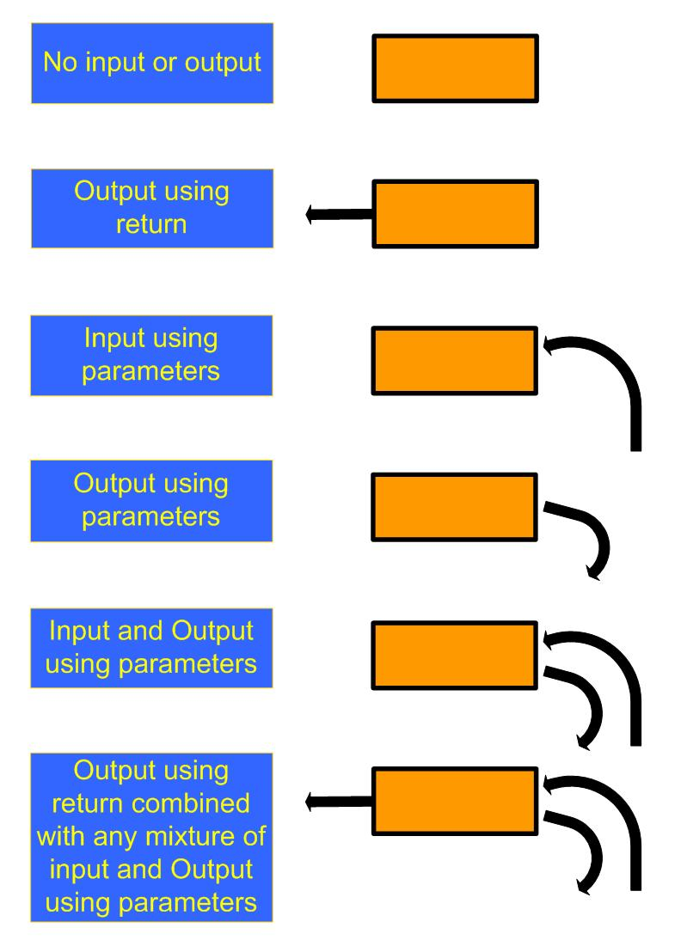
Communication

Slide 38
Communication

Slide 39
Parameters - call by copy
When a function is called, the value of the parameters are calculated and passed to the function for execution.
Within the function, the parameters act like local variables.
The value of the variables used in the parameter list are unchanged.
Called "call by copy" because a copy of the variable is made.

Slide 40
Parameters - call by copy
//Calculate the area of a box
void calcArea( float width, float height )
{
float area;
area = width * height;
cout << "Area = " << area << endl;
}
int main()
{
calcArea(5.7, 4.3);
}

Slide 41
Reference parameter
A copy of the variable is not being used. Rather the actual variable itself is being accessed by the function.
Called "call by reference" because this operation is carried using the address of the variable passed over to the function.
Place an ampersand (&) just before the name of the variable.
void foo(int &a)
Subsequent use of the variable is per normal.

Slide 42
Reference parameter
void subtract_two(int &num)
{
num = num - 2;
}
int main()
{
int number;
number = 3;
subtract_two(number);
cout << "Inside main: " << number << endl;
}

Slide 43
return
float calcArea( float width, float height )
{
float area;
area = width * width;
return area;
}
int main()
{
cout << calcArea(5.7, 4.3);
}

